Slide 1
Modules
A module is a mechanism to group components, directives, pipes and services that are related, in such a way that can be combined with other modules to create an application.
A module can export or hide components, directives, pipes and services. The exported elements are meant to be used by other modules, while the ones that are not exported are just used inside the module itself and cannot be directly accessed by other modules of our application.

Slide 2
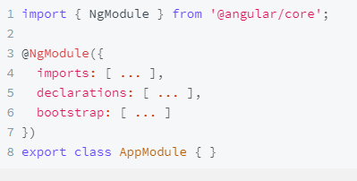
To be able to define modules we have to use the decorator NgModule.
An Angular Decorator is a function, using which we attach metadata to a class, and class members
Imports makes the exported declarations of other modules available in the current module.
declarations are used to declare components, directives, pipes that belong to the current module. Everyone inside declarations knows each other.
Providers are used to make services and values known to dependency injection.
The bootstrap property is where we define the root component of our module.

Slide 3
Components
The Component is the main building block of an Angular Application.
The Component contains the data & user interaction logic that defines how the View looks and behaves.
Decorator that marks a class as an Angular component and provides configuration metadata.
A component must belong to an NgModule in order for it to be available to another component or application

Slide 4
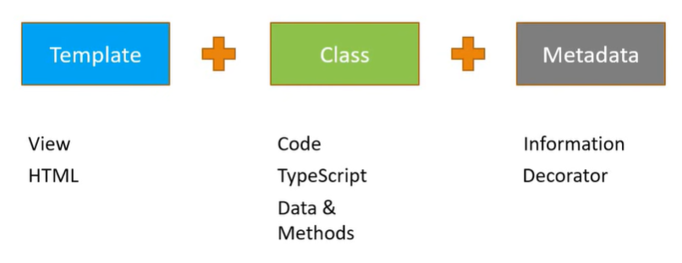
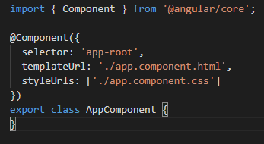

Slide 5
Directives
Angular 8 directives are DOM elements to interact with your application and enables logic to be included in the Angular templates.
Types of Directives
Components
Structural Directives
Attribute Directives

Slide 6
Components
Special kind of directives having their own template
@Component decorator identifies the class immediately below it as a component class

Slide 7
Structural Directives
Change the DOM layout by adding and removing DOM elements
An asterisk(*) precedes the directive attribute name
They can add , remove and manipulate the elements
The commonly used built-in structural directives are *ngIf and *ngFor.

Slide 8
Attributes Directives
Change the appearance or behaviour of a DOM element
Requires a controller class anotated with @Directive
The most commonly used, built-in attribute directives are ngStyle and ngClass.

Slide 9
Data Binding
Means to bind the data from view(template) to controller(component class) and vice versa
Types of data binding
One way data binding
Two way data binding

Slide 10
One way Data Binding
String interpolation

